Slide 1
Project: Virtual Queue 2.0 Student: Kenneth Kon Michael Lazo Mentor: Bernard Parenteau
Project Plan
CIS 4911 Senior Project
School of Computing and Information Sciences
Florida International University
<02/02/2015>

Slide 2
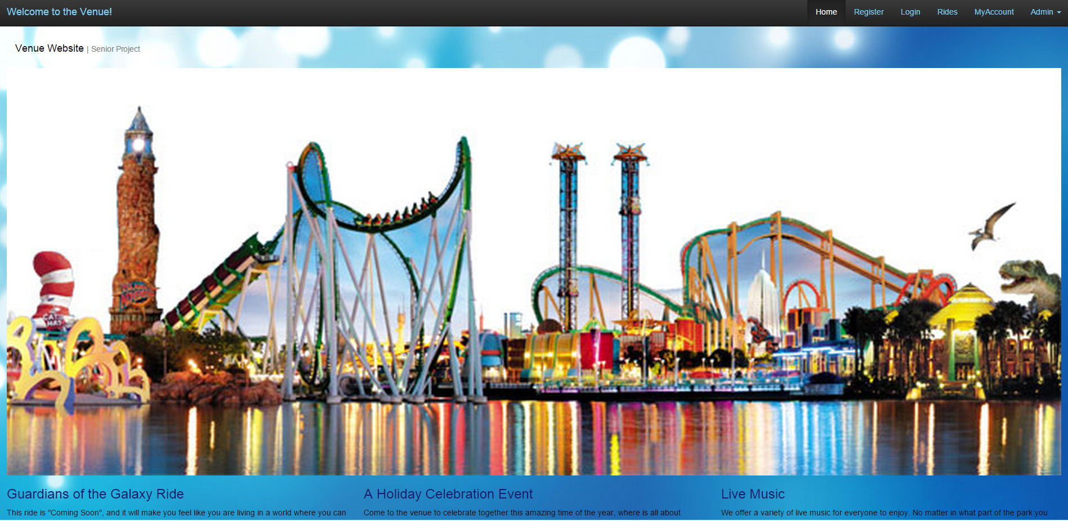
Virtual Queue
Notes:
Explain the scope of the project. What it is. Target client.

Slide 3
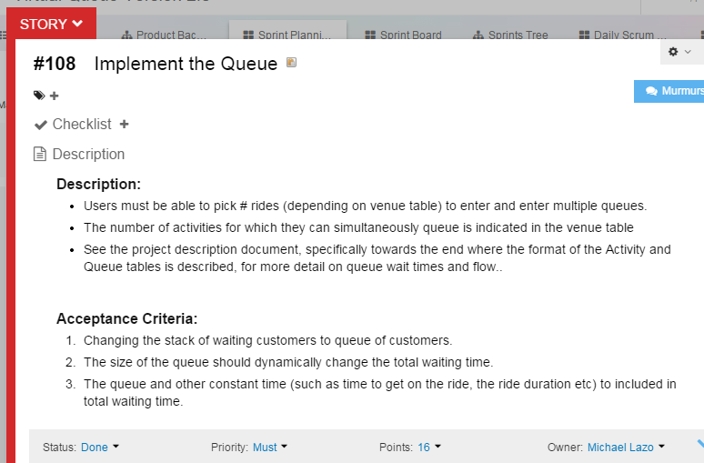
User Story

Slide 4
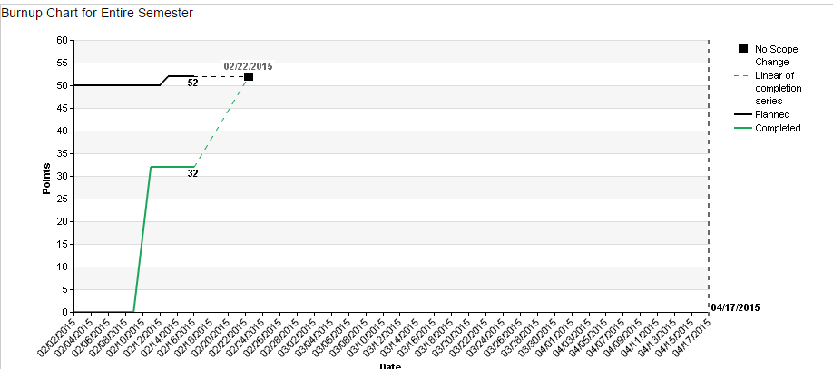
Burn-up/Burn-down charts

Slide 5
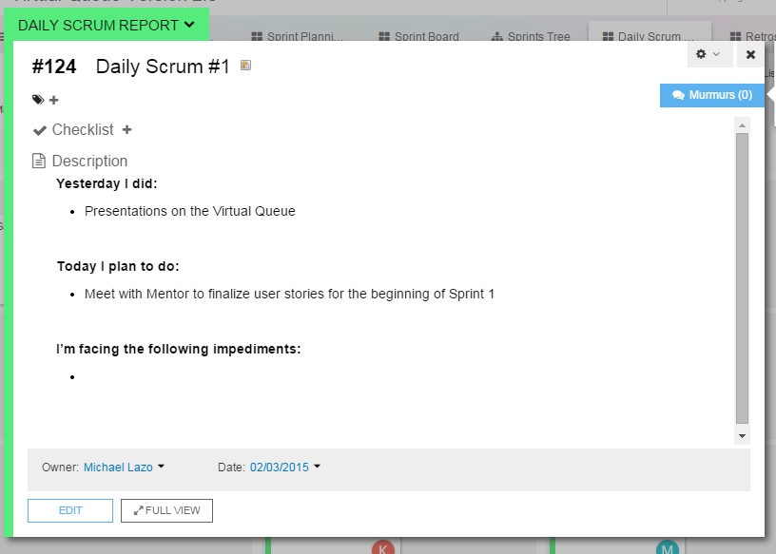

Slide 6
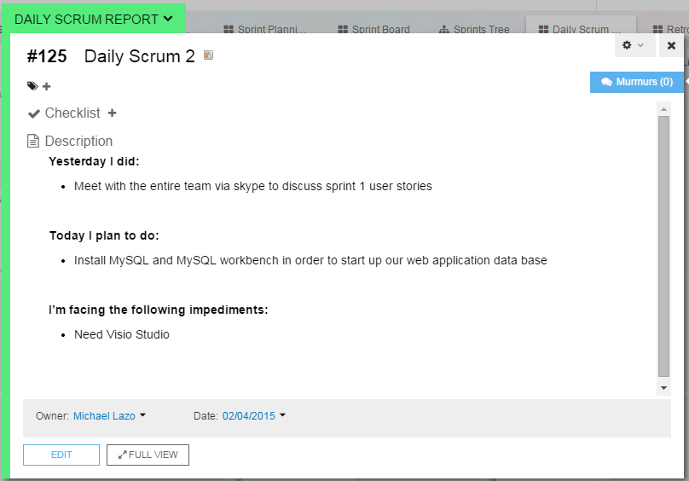

Slide 7
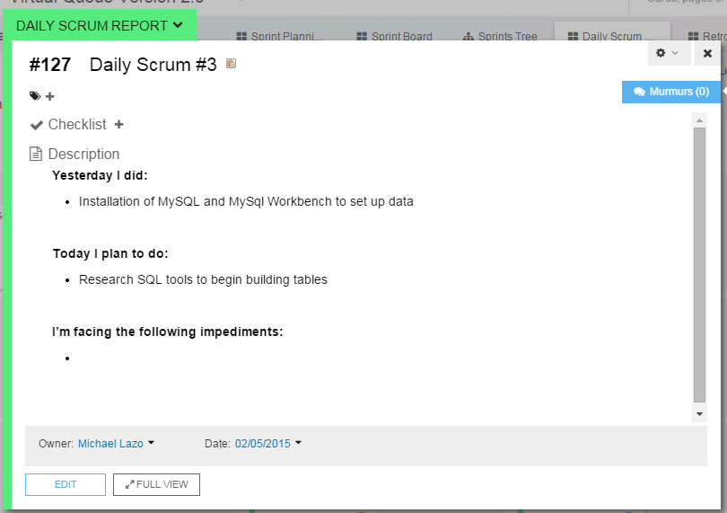

Slide 8
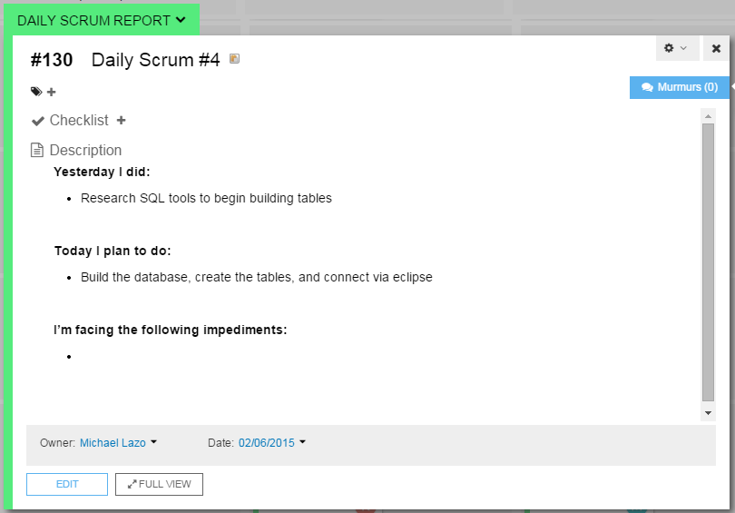

Slide 9
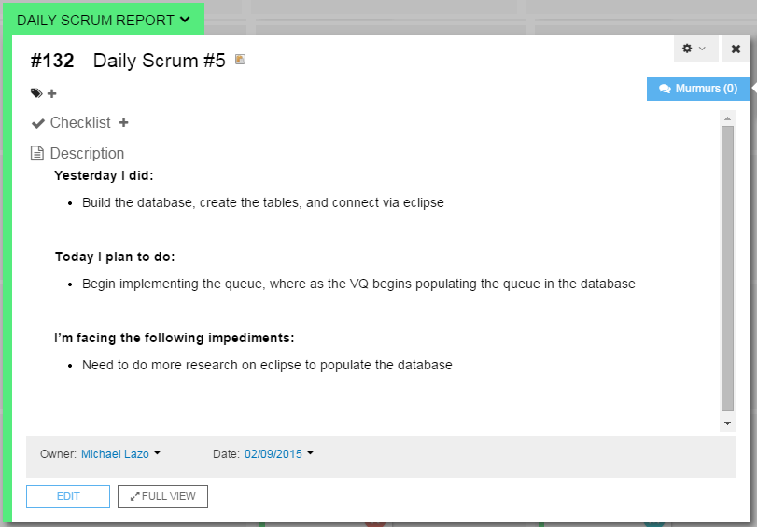

Slide 10
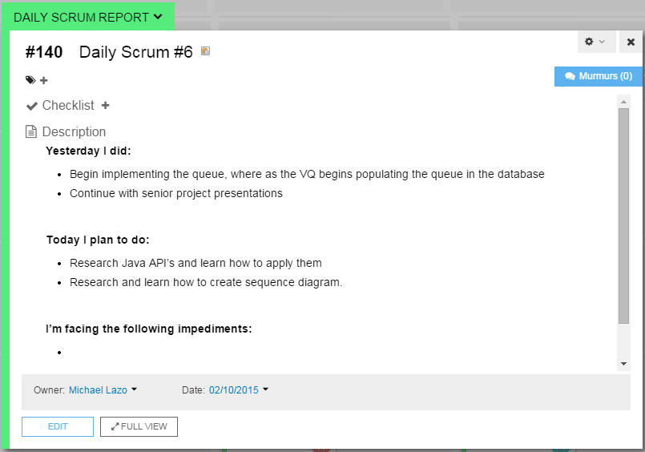

Slide 11
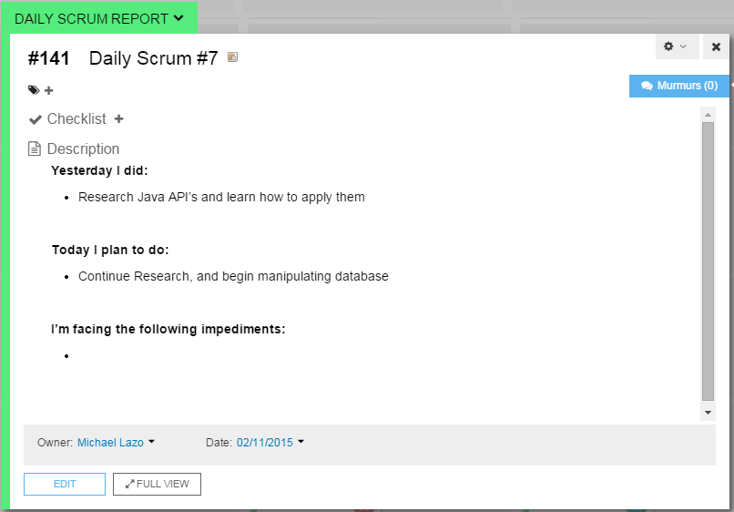

Slide 12
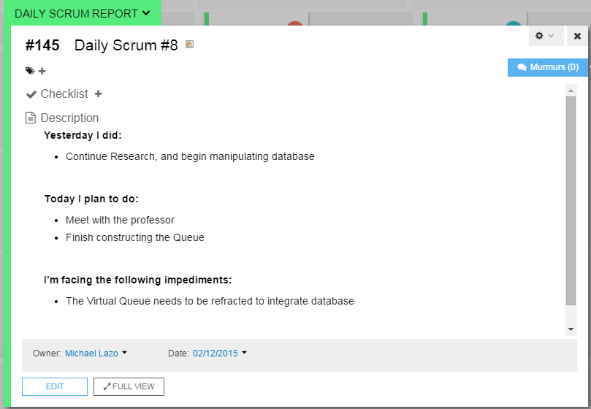

Slide 13
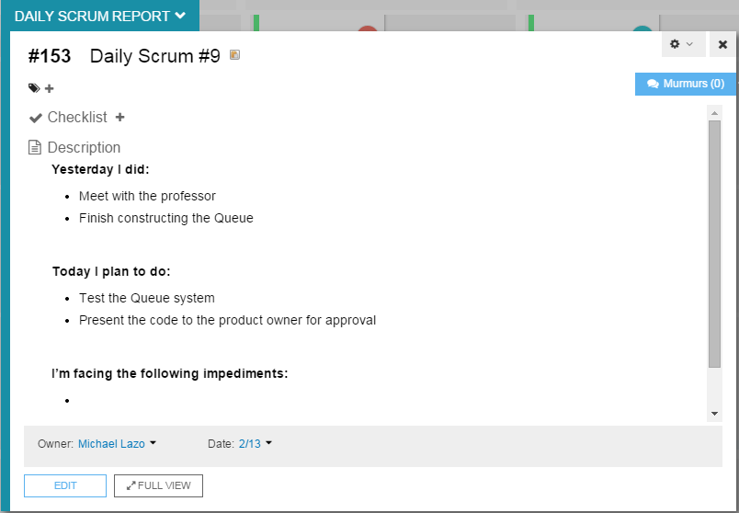

Slide 14
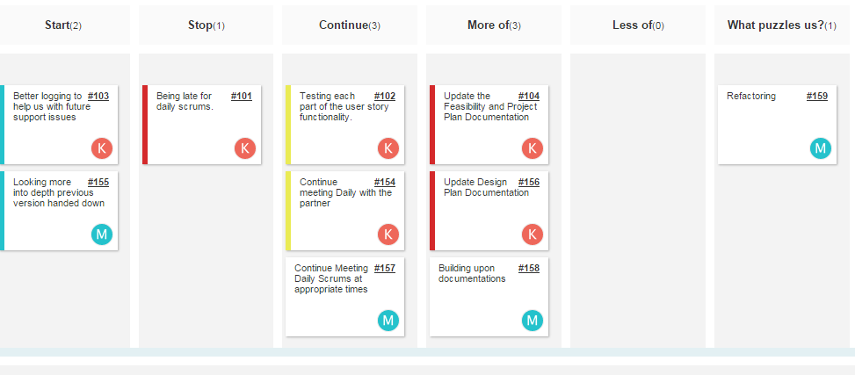
Retrospectives

Slide 15
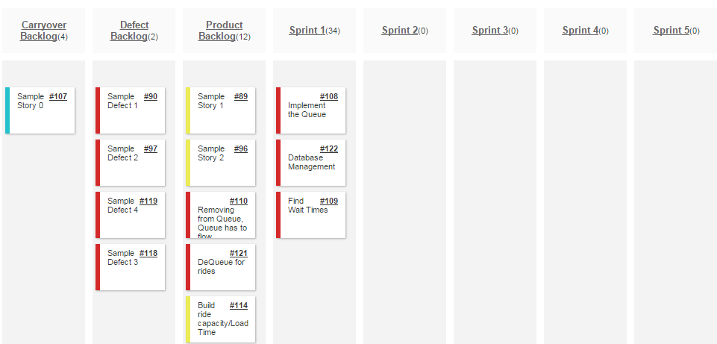
Review Sprint 1

